Slide 1
Financial Aid Overview
Presented by the
Office of Student Financial Assistance (OSFA)

Slide 2
Financial Aid Overview
2025-26 High School Student Graduates
Enrolling/Applying for the
2026-27 Academic Year

Slide 3
Financial Aid has its own language and acronyms:
  COA - Cost of Attendance
  CSS Profile - College Scholarship Service Profile
  FAFSA - Free Application for Federal Student Aid
  FSA ID - Federal Student Aid Identification
  FSS - FAFSA Submission Summary
  SAI - Student Aid Index
  FFAA - Florida Financial Aid Application
  ED/FSA - U.S. Department of Education/Federal Student Aid
  FLDOE/OSFA - Florida Department of Education/Office of Student Financial Assistance

Slide 4
Agenda
  What is Financial Aid?
  Where do I Find Financial Aid?
  How and When Do I Apply?
  Who Can Help me?

Slide 5
What is Financial Aid?
Monies received from four sources:
  Federal
  State
  Institutional
  Private
May also be categorized as:
  Gift Aid
  Self Help
  Need-based
  Merit-based
May cover direct or indirect costs

Slide 6
What is Financial Aid?
Monies received from four sources:
Federal Aid:
  Pell Grant (Gift Aid) (Need-based)
  Work Study (Self-Help)
  Federal Student Loans (Self-Help)
    Student (Subsidized/Unsubsidized)
    Parent Loans

Slide 7
What is Financial Aid?
Monies received from four sources:
State Aid:
    Benacquisto (Merit-based)
    Bright Futures Scholarship (Merit-based)
        Academic/Medallion/Gold Seal Vocational/Gold Seal CAPE
    Florida Work Experience Program (Self-Help)
    Effective Access to Student Education
    Additional programs can be found at www.FloridaStudentFinancialAidsg.org

Slide 8
What is Financial Aid?
Monies received from four sources:
Institutional Aid:
    Academic (Gift Aid) (Merit-based)
    (Need-based)
    Major/Specific Study (Gift-Aid)
    (Merit-Based)

Slide 9
What is Financial Aid?
Monies received from four sources:
Private:
    School (Gift Aid) (Merit-based)
      High School/Postsecondary Institution
    Employment
      Students/Parents

Slide 10
College Cost
Cost of Attendance (COA) varies from:
  Institution to Institution
  In State vs. Out of State
  On Campus vs. Off Campus
COA = Direct Cost + Indirect Cost
  Net Price Calculator
  Requirement for every institution

Slide 11
College Cost
Public 2-year college (tuition and fees, in-state) $3,205
Public 4-year college (tuition and fees, in-state) $6,093
Public 4-year college (tuition and fees, out-of-state) $28,240
Private 4-year college (tuition and fees) - $39,400
  Sources: State University System of Florida, Florida College System and College Board-Big Future

Slide 12
Where do I Find Financial Aid? Financial Aid Applications
Free Application for Federal Student Aid (FAFSA)
Florida Financial Aid Application (FFAA)
College Scholarship Service Profile (CSS Profile)
Institutional Applications
Private Scholarships

Slide 13
Free Application for
Federal Student Aid (FAFSA)
Federal government is largest source of student aid; FAFSA distributed and processed by the U.S. Department of Education.
        Manual or electronic options
        2026-27 FAFSA is scheduled to open October 1, 2025
Must be completed annually (per academic year) to be evaluated for financial aid

Slide 14
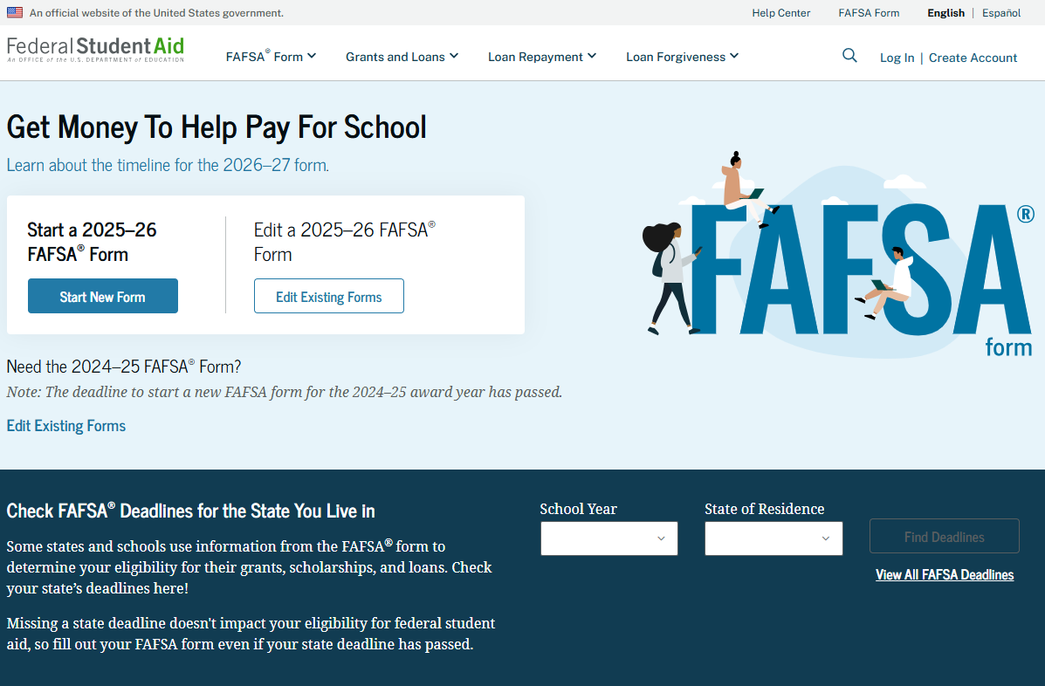
FAFSA website: studentaid.gov

Slide 15
FAFSA Getting Started
Gather important data
Monitor priority deadlines
  State and institutional deadlines
  Confirm FAFSA dependent vs independent requirements
    Dependent students are required to include parent/contributor information
    Independent students are not required to include parent/contributor information
  Search for school codes

Slide 16
FAFSA Submission Summary (FSS)
Provides basic information about federal student aid eligibility
Received (after you submit the FAFSA) via email within 3-5 days if you provided an email address
Correct errors, if needed
Will contain a Student Aid Index (SAI)
    Assists institutions in the financial aid award packaging process

Slide 17
FAFSA Additional Information
Contact institution:
    To determine award disbursement process
    For special circumstances of professional judgment review
    To determine what other types of aid applications are necessary

Slide 18
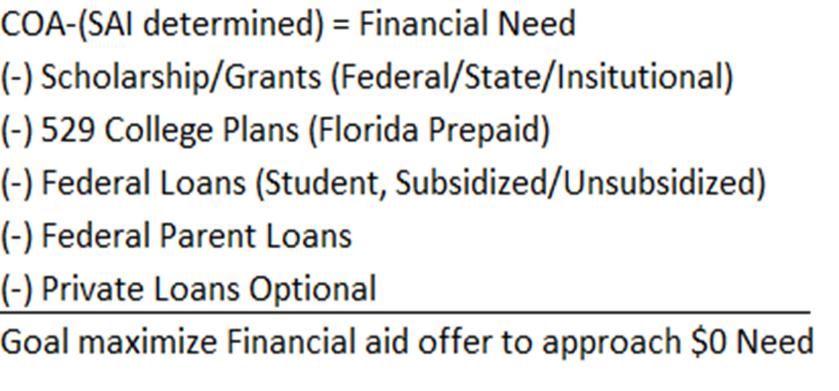
FAFSA Additional Information
Verification Process
Communication with Postsecondary Institutions
Offer of Financial Aid:

Slide 19
Florida Financial Aid Application
The Florida Financial Aid Application (FFAA) opens October 1
Apply Early – must be completed prior to August 31 of high school graduation year
One application is used for multiple programs, not just the Florida Bright Futures Scholarship Program
Students may login to view status, online notifications, and award history
Apply at www.FloridaStudentFinancialAidsg.org

Slide 20
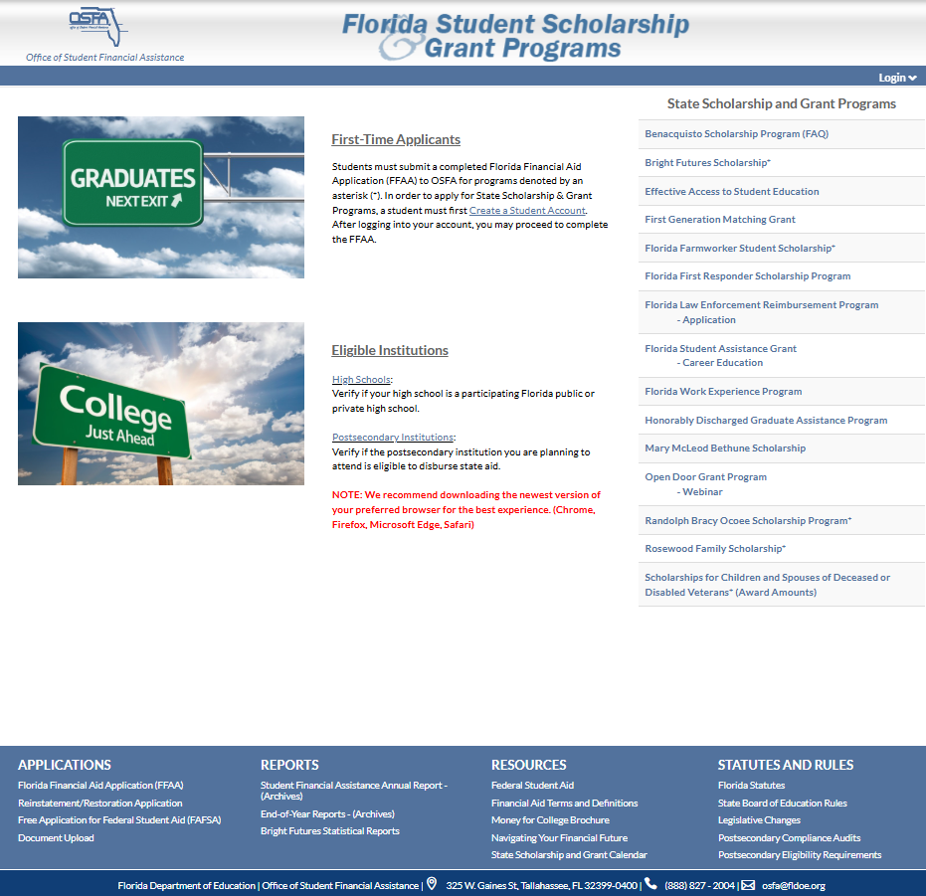
Florida Financial Aid Application

Slide 21
Florida Financial Aid Application
State Scholarship and Grant Programs requiring a timely completed Florida Financial Aid Application:
Florida Bright Futures Scholarship Program
Scholarship for Children and Spouses of Deceased or Disabled Veterans
Rosewood Family Scholarship
Florida Farmworker Student Scholarship
Randolph Bracy Ocoee Scholarship

Slide 22
State Scholarship and Grants
Need-Based Programs:
  Florida Student Assistance Grant (FSAG)
  Florida Work Experience Program (FWEP)
  Honorably Discharged Graduate Assistance Program (HDGAP)
  Tuition Assistance Program
    William L. Boyd, IV, Effective Access to Student Education Grant Program (EASE)

Slide 23
State Scholarship and Grants
Merit-Based Programs:
  Florida Bright Futures Scholarship Program
  Benacquisto Scholarship Program

Slide 24
State Scholarship and Grants
Other Programs:
    First Generation Matching Grant (FGMG)
    Florida Farmworker Student Scholarship (FFSS)
    Florida First Responder Scholarship Program (FFRSP)
    Mary McLeod Bethune Scholarship (MMB)
    Open Door Grant Program (ODGP)
    Randolph Bracy Ocoee Scholarship (OCOE)
    Rosewood Family Scholarship (RFS)
    Scholarships for Children and Spouses of Deceased or Disabled Veterans (CSDDV)

Slide 25
State Scholarship and Grants
Florida Bright Futures Scholarship Program for Home Education/Personalized Education Program students:
    Meet the General Requirements for a Bright Futures Award;
    Submit a timely FFAA;
    Earn required minimum test scores; and
    Complete the minimum number of volunteer service hours, paid work hours, or combination of 100 total hours.

Slide 26
Private Scholarships
Search Criteria:
  Targeted Searches
    Schools (high school/postsecondary institution)
          Private Scholarship list website (traditionally requires separate application)
    Scholarships at specific college
    Place of employment (students/parents)
    National websites

Slide 27
Review Action Items:
Federal – Financial Aid (FAFSA)
    Monitor application opening date: October 1, 2025
    Create an FSA ID and password NOW
  State – Financial Aid (FFAA)
    Monitor application opening date: October 1, 2025
    Ensure requirements are met
    General Requirements
    Scholarship Program Requirements
    Private Scholarships – apply, apply, apply
    CSS Profile – If institution requires
    Additional required institutional applications

Slide 28
Additional Information
Office of Student Financial Assistance
State Scholarship and Grant Programs
Website: www.FloridaStudentFinancialAidsg.org
www.navigatingyourfinancialfuture.org
Email: Pedro.Hernandez@fldoe.org
Telephone: (850) 245-1821

